Slide 1
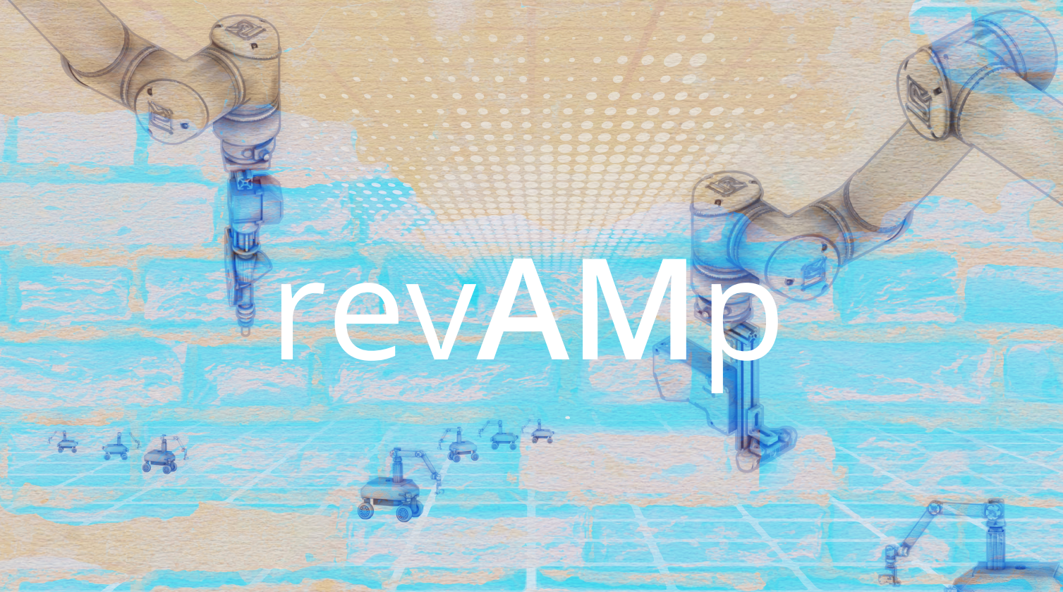

Slide 2


Overview
Session 1
09:00-09:30
Welcome and workshop introduction
Introduction round by students
Work Flow Explanation
Session 2
09:30-11:00
Sensing and data gathering Lecture
Robot approach + Rough and Fine scanning Exploration
Exploration presentations
Session 3
11:30-12:30
Data evaluation Lecture
Point-cloud to Volume Exploration
Session 4
13:30-14:45
Design and Fabrication Lecture
Design studies Exploration
Design presentations
Session 5
14:45-15:30
Fabrication Exploration I
Session 6
16:00-18:00
Fabrication Exploration II
Review and reflections on the result

Slide 3

Session 3
Surface creation
Point-cloud to building area
Notes:
Picture from:
point cloud to surface - Bing images

Slide 4
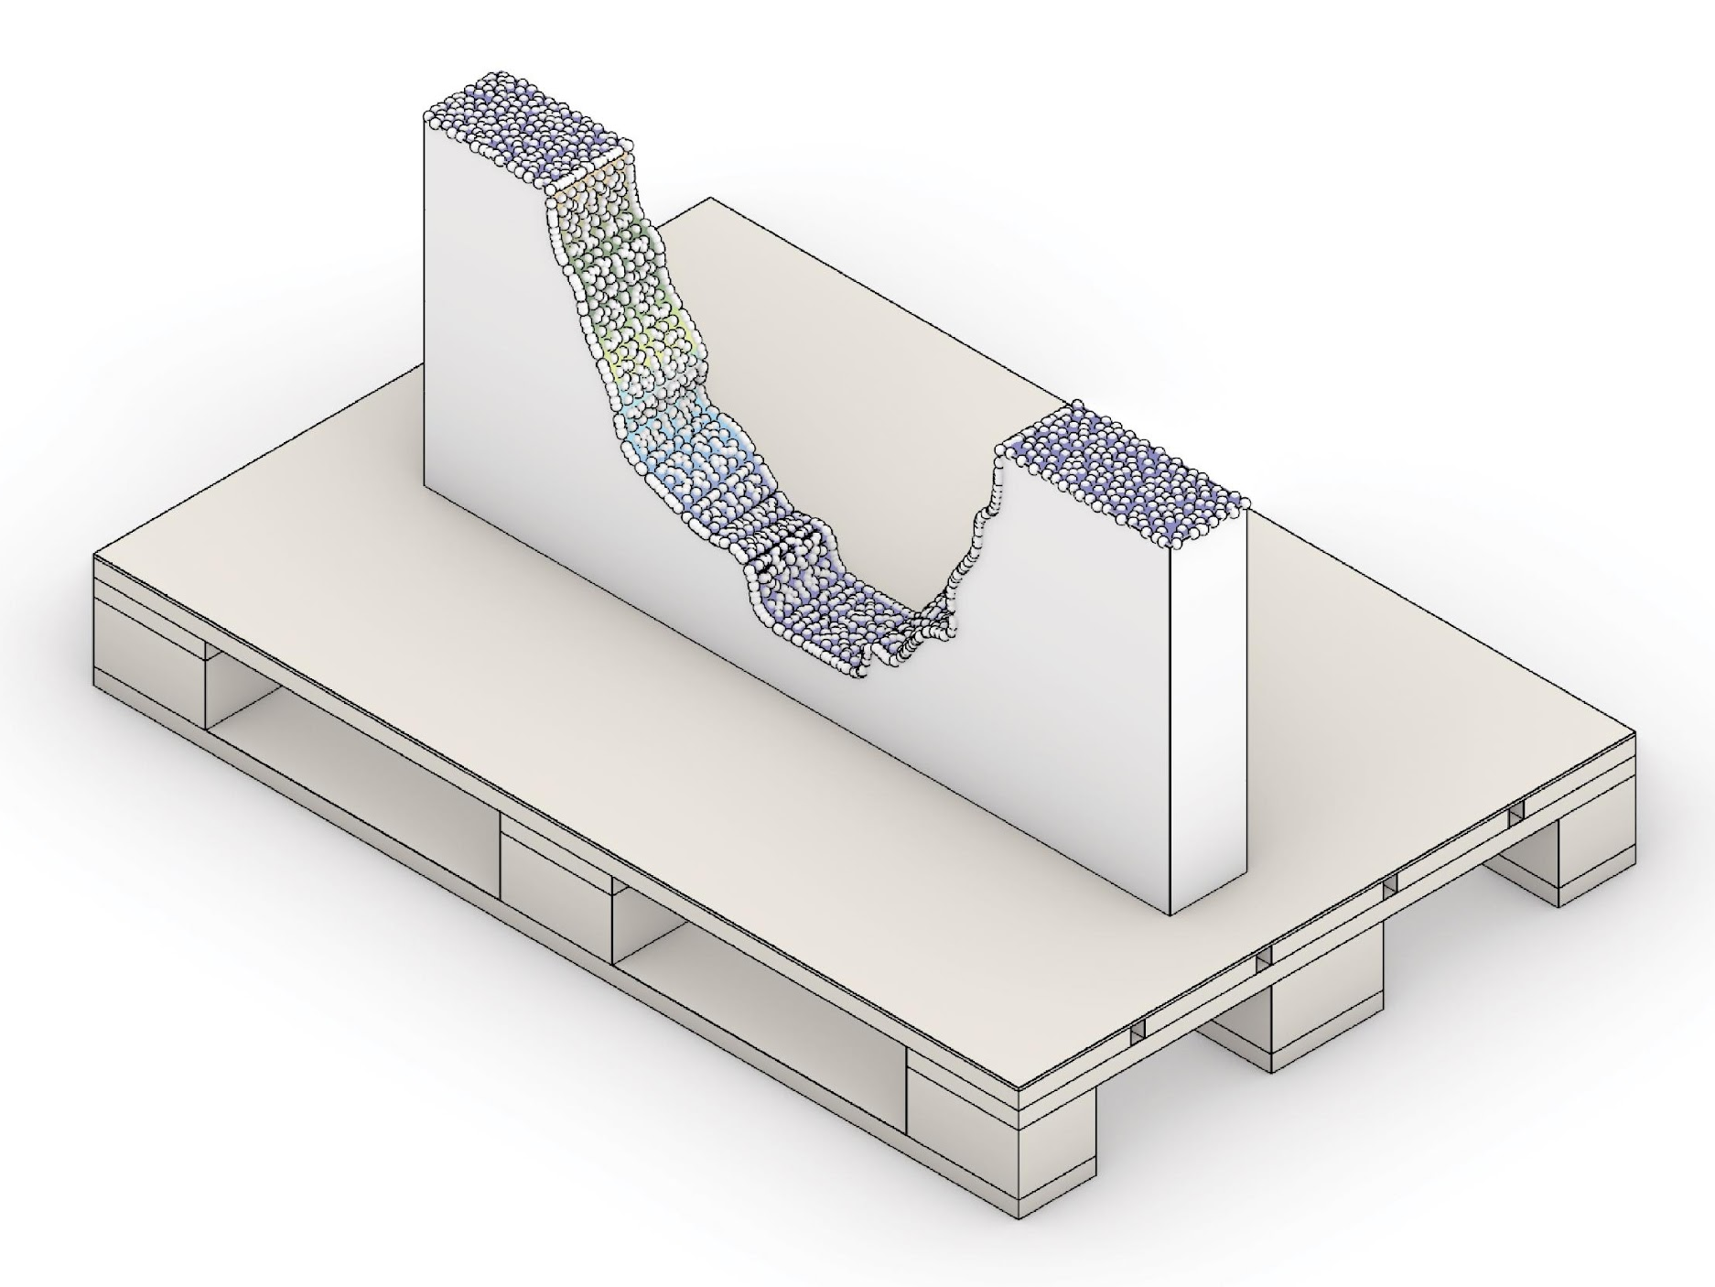
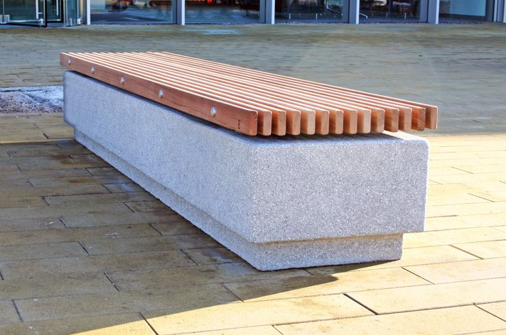
Introduction
Point cloud data evaluation and desired outcome
?
Notes:
We still want to complete the segment to revamp our broken wall.
So, how to get from the point cloud closer to the final object?

Slide 5
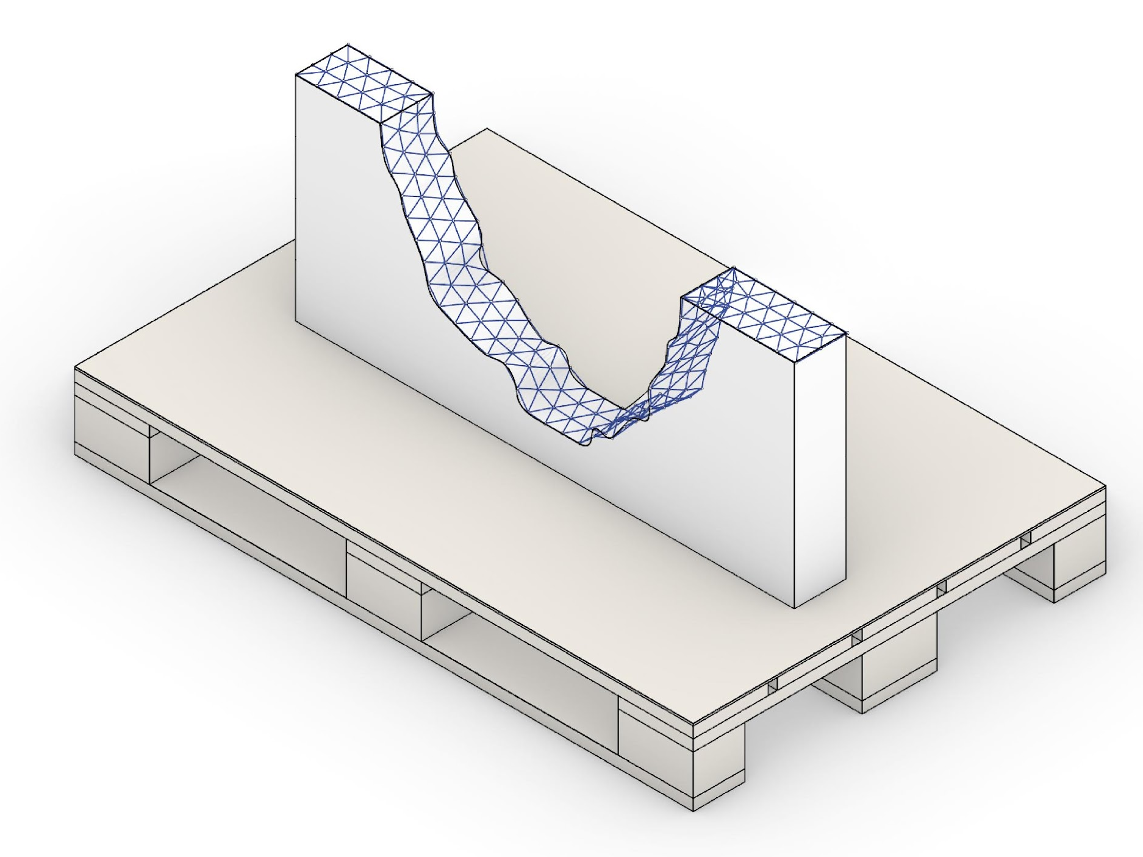
Introduction
Print-base is a closed surface
Notes:
A closed surface representation will help trim or design objects to be printed on the wall segment.
And it can also be utilized to define the missing volume.
This can be reconstructed based on an point cloud resulting from a 3D scanning process.

Slide 6
Introduction
Original volume
Noor frage…

Slide 7
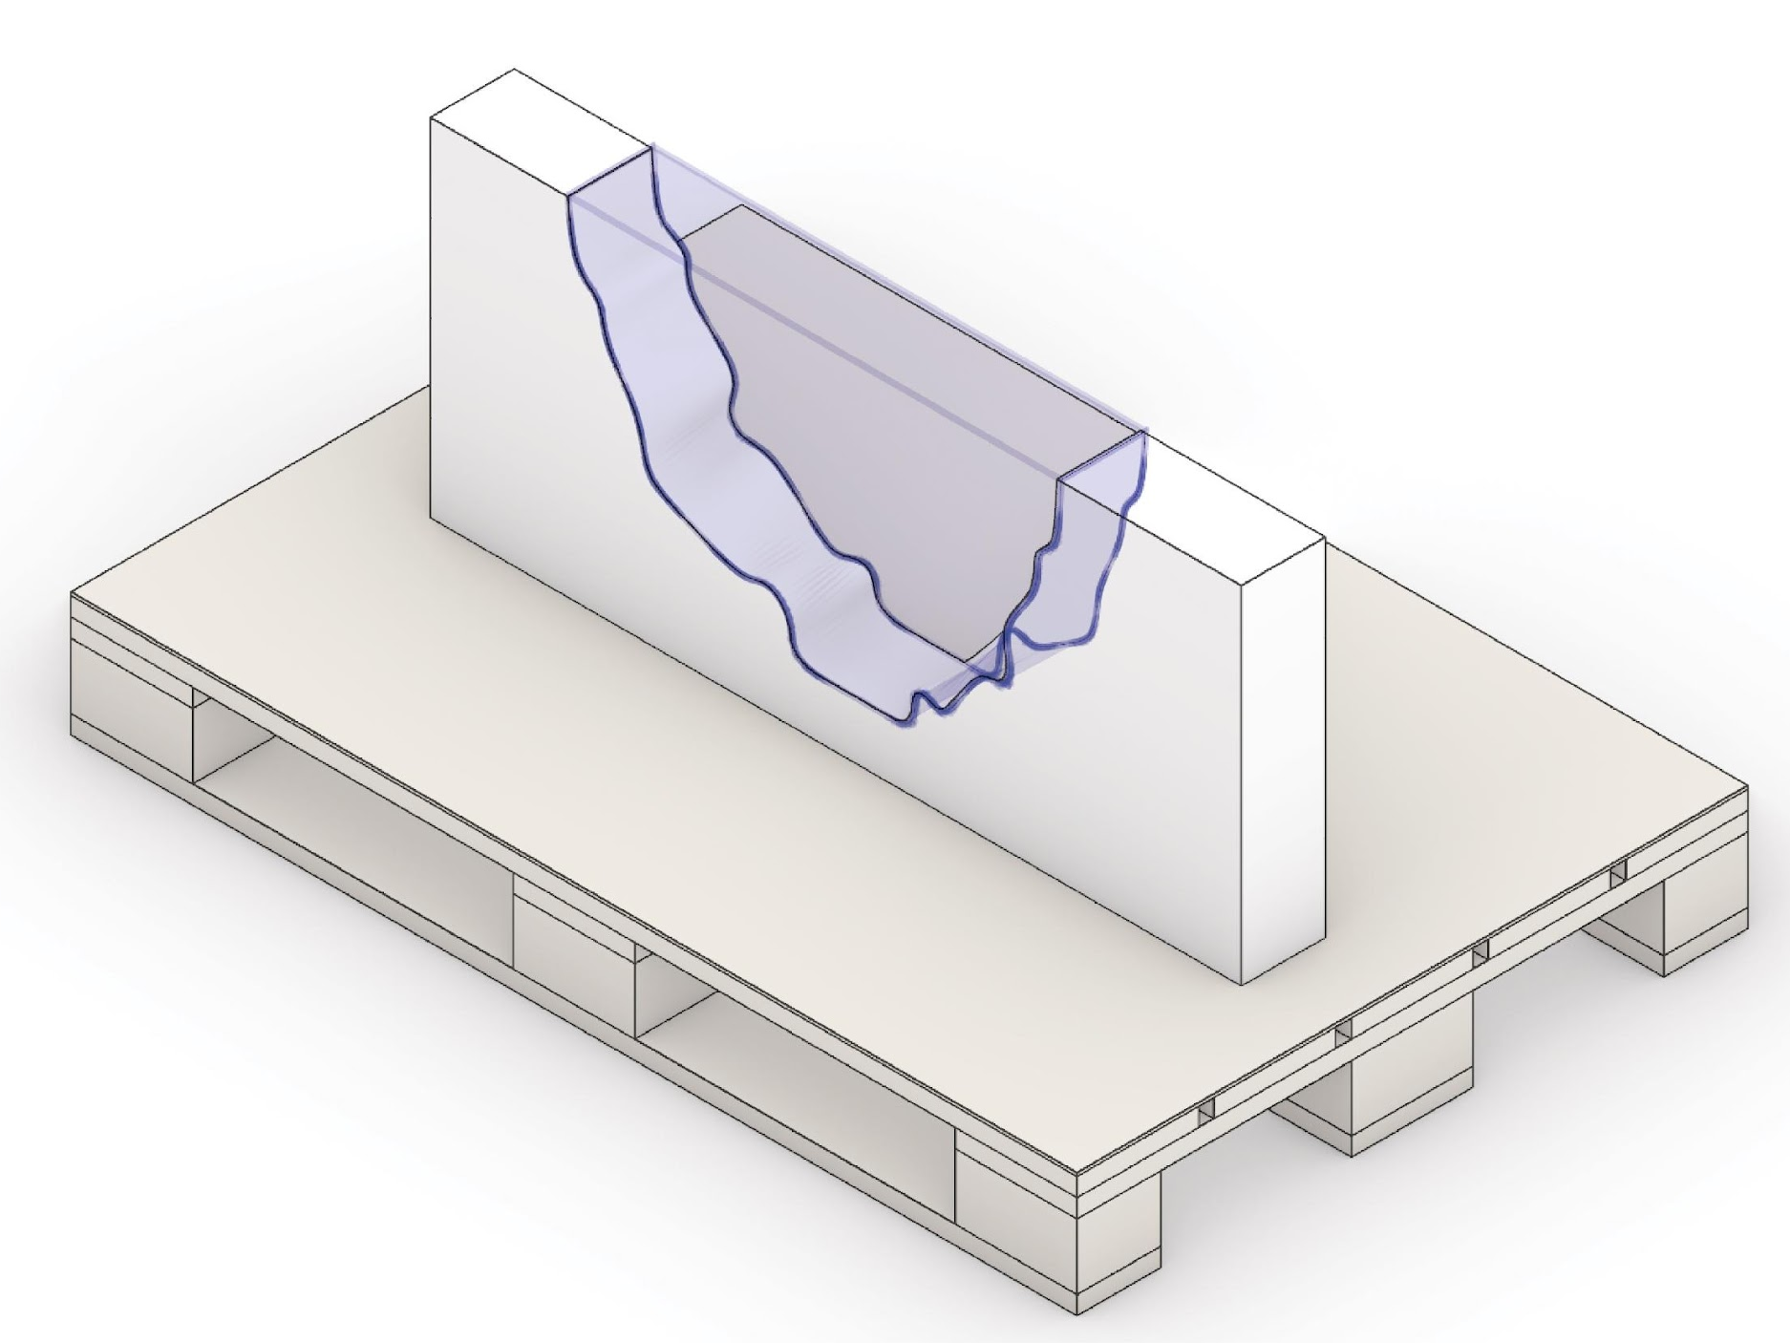
Introduction
Missing volume
Notes:
We have to fill in the missing gap.
However, this highly depends on the final geometry we want to build.
Furthermore, we can not extrapolate the data beyond the point cloud.

Slide 8
Workflow
Region of interest
Surface reconstruction
Sample object
Notes:
We choose a 3 step approach to perform the reconstruction.
At first, we will define a region of interest.
The second step requires the adjustment of the surface parameters, such as density, to reach the required accuracy while avoiding errors.
And finally, we will end up with a reconstructed surface for object design.

Slide 9
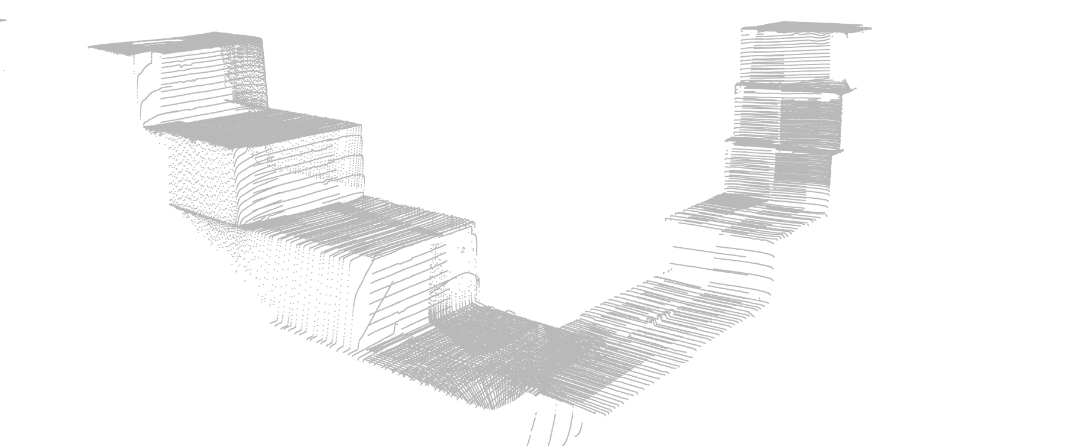
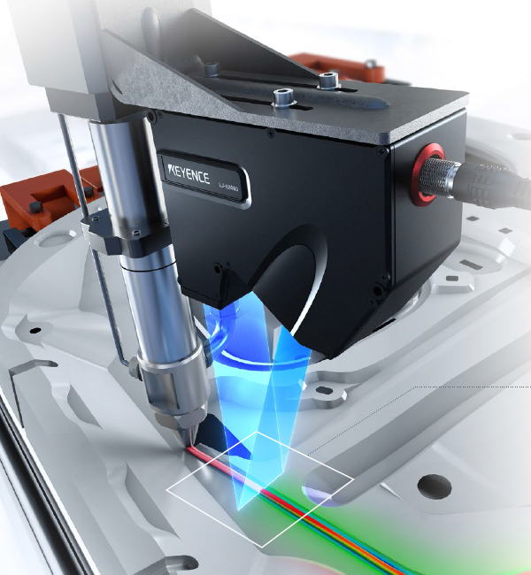
Redion of interest
Raw Point Cloud Data
Notes:
Image of the raw point cloud data.
Since we use a 2D line laser, the point cloud depicts multiple „lines of points“
Defining a region of intereset will help to bring down calculation time.
And increase stability for reconstructed surfaces.
No information about the to be printed part is given.
ROI must be defined manually.

Slide 10
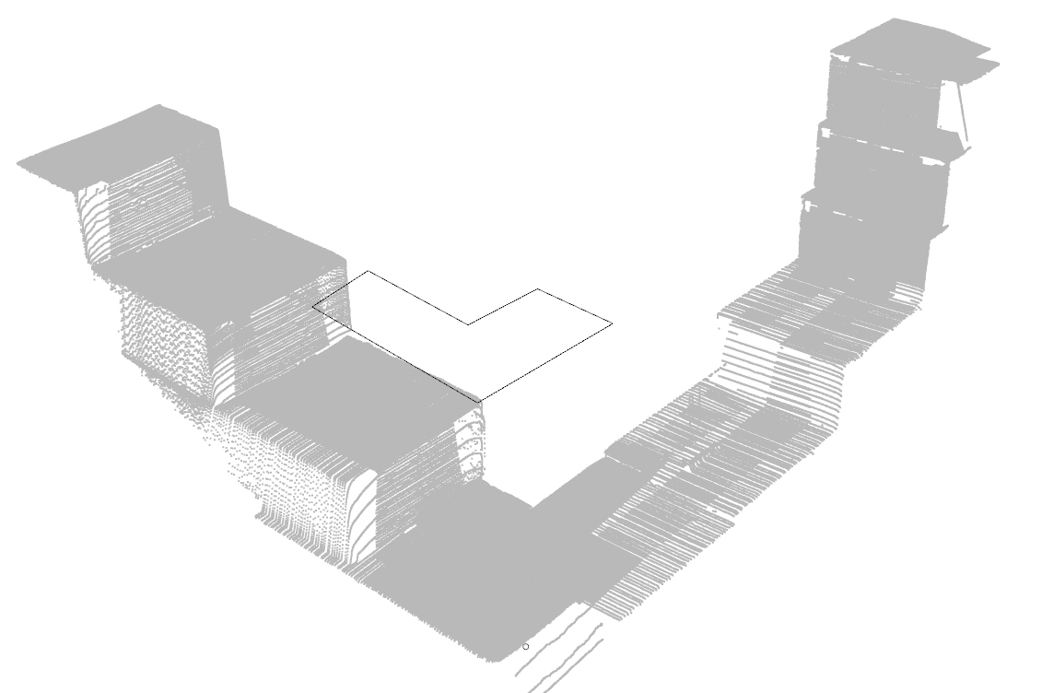
Region of interest
2D-sketch above the point cloud
Notes:
Image of the raw point cloud data.
Defining a region of intereset will help to bring down calculation time.
And increase stability for reconstructed surfaces.
No information about the to be printed part is given.
ROI must be defined manually.

Slide 11
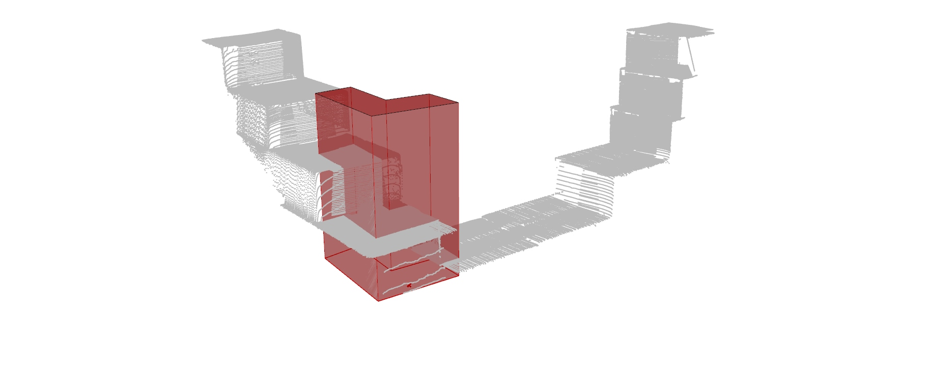
Region of interest
Extrusion towards the point cloud
Notes:
We will extend the defined region towards the point cloud.
In our case simple z-direction is sufficient.
More complex methods can be thought of.
However, this approximation is usually enough for 2.5D printing operations due to the small laser-scanning distance.

Slide 12
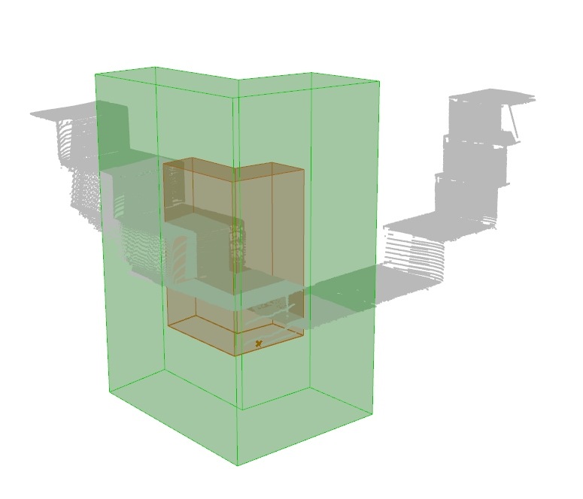
Region of interest
Equal scaling to generate ROI
Notes:
We are upscaling the boundary volume to add some design flexibility.

Slide 13
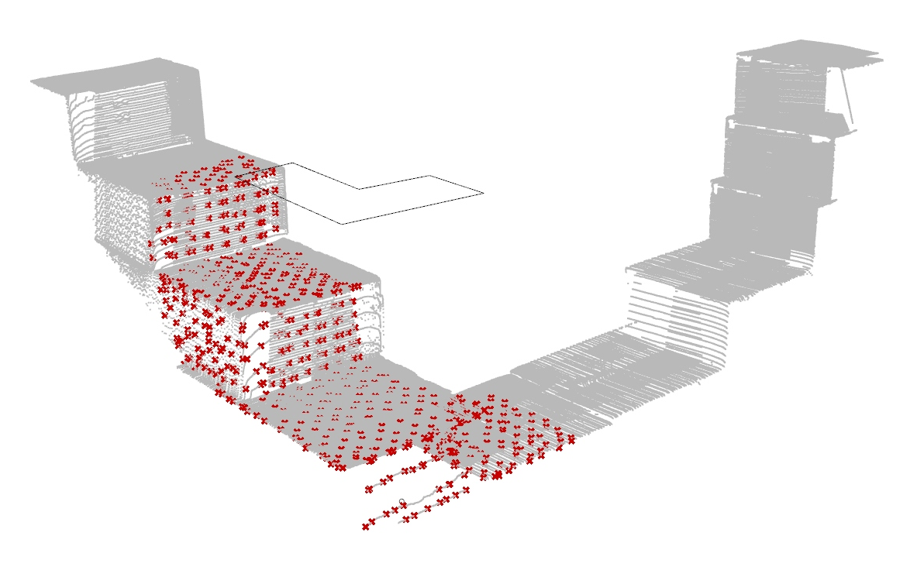
Parameter adjustment
Subsampling by 10
Notes:
Points within the ROI.
A high subsampling is used to avoid measurement errors and closed surface generation.
Subsampling factor ~10, this is possible due to the dense point clouds provided by the laser scanner.

Slide 14
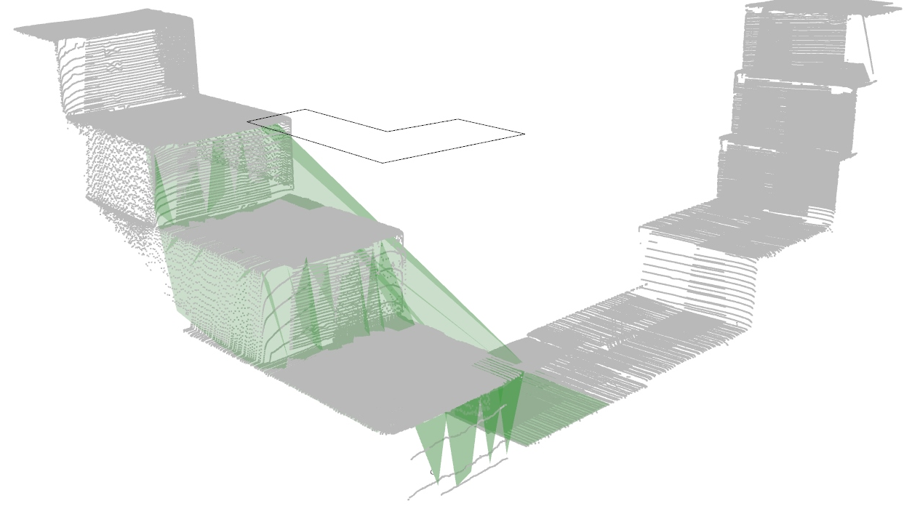
Parameter adjustment
Utilization of Delaunay-Triangulation Face-Count 200, Accuracy 10mm
Notes:
Surface reconstruction, in our case, is based on a simple Delaunay-Triangulation.
High point cloud density, however, requires further data reduction to avoid mesh faults.
Currently, the settings are recommended to be 200 Faces and an accuracy of 10 mm.
Further research will look at more advanced reconstruction techniques to increase the degree of automation.

Slide 15
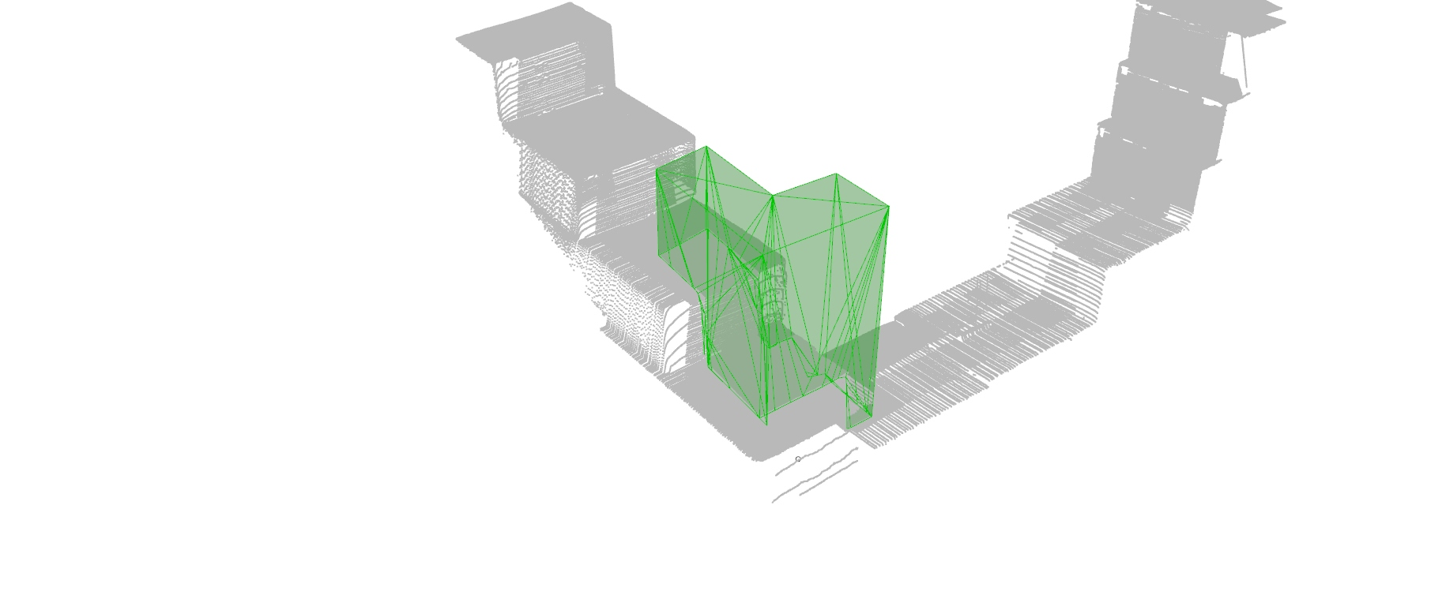
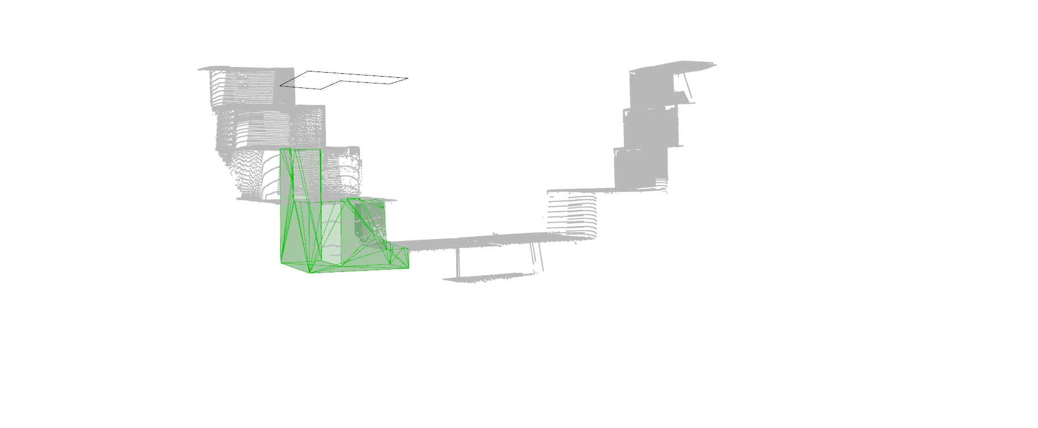
Sample object
Top or bottom
Notes:
The reconstructed surface is used to trim a sample object's designed object.
We must decide if we want to progress with the top or bottom part.

Slide 16
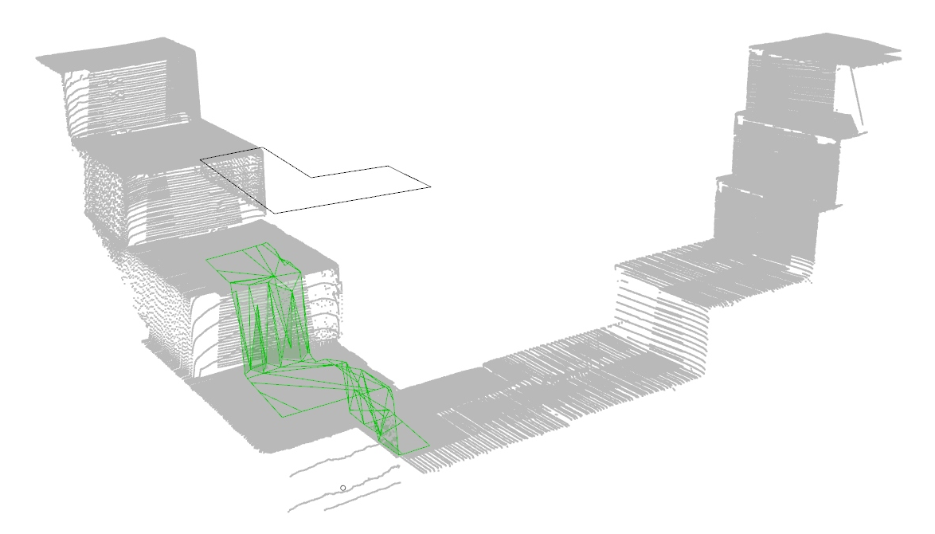
Sample object
Slice the surface with the object
Notes:
Afterwards, we use the object to get the part of the surface forming the bottom of the sliced object.

Slide 17
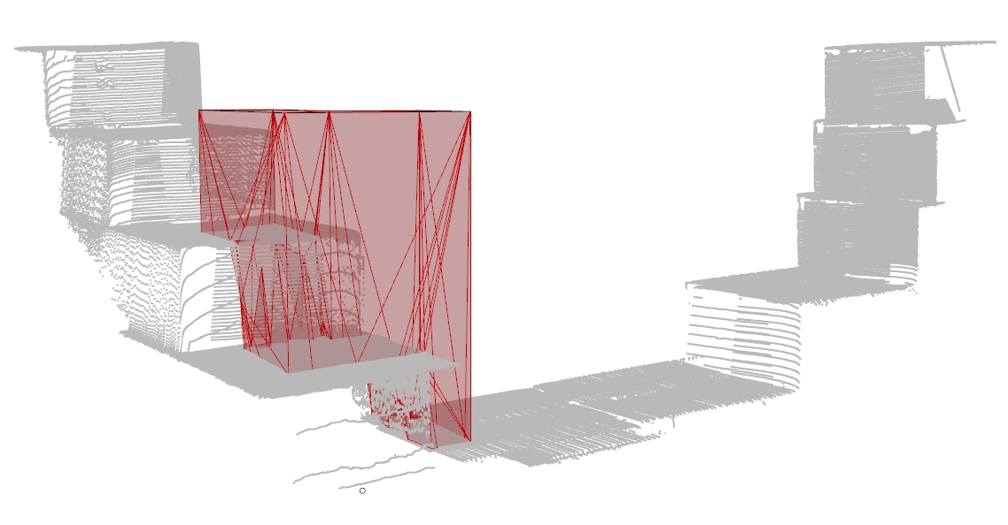
Sample object
Combination of sliced surface and object
Notes:
Within the last step, we need to merge the sliced object with the cutaway of the surface.

Slide 18
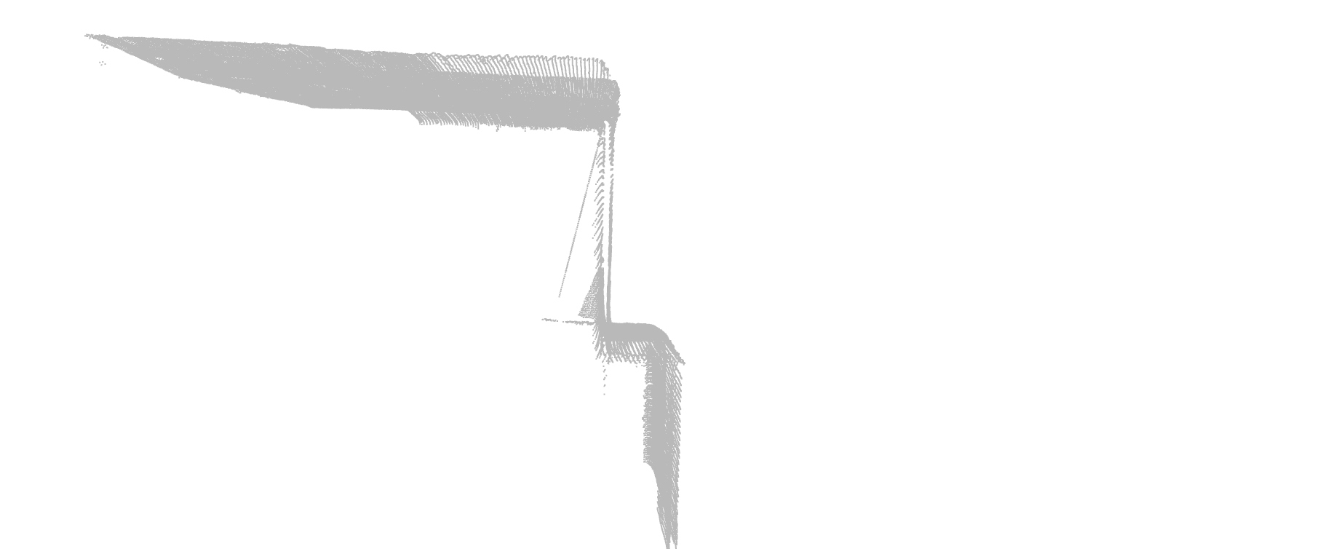
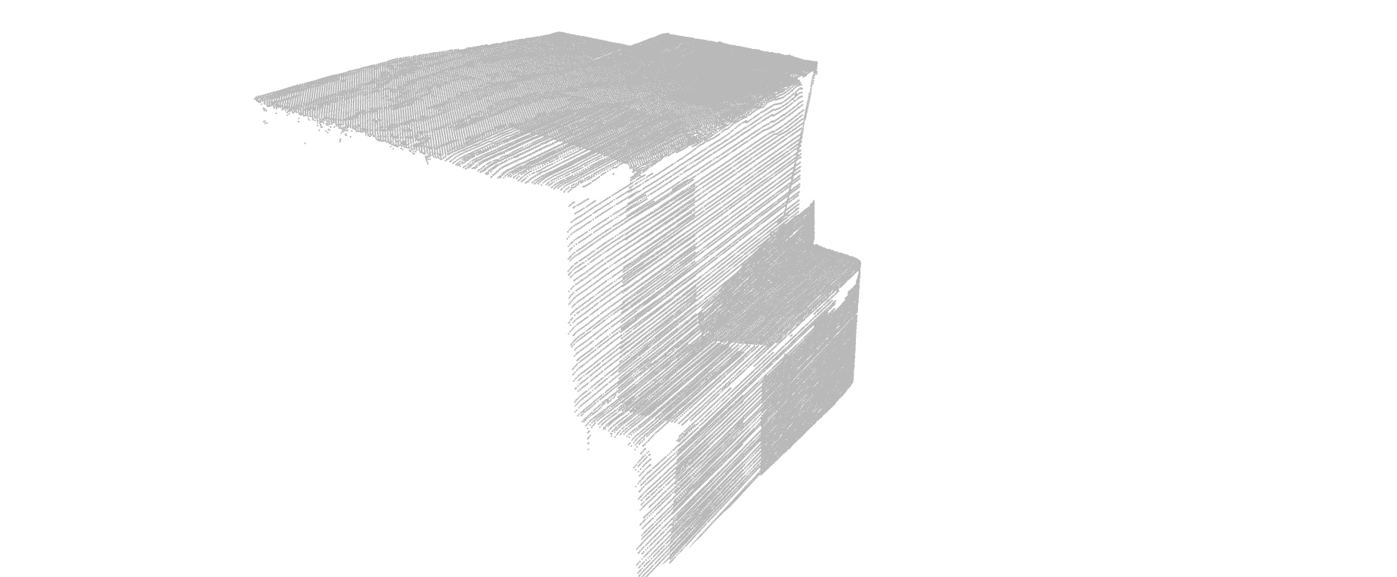
Challenges
Points within the objects
lead to a second wall
Notes:
Main future challenge Is development of advanced point cloud evaluation.

